Slide 1

SPRING BOOT
-Aishwarya Sawant ☺

Slide 2
WHAT IS SPRING BOOT?
Takes an opinionated view of building Spring applications.
Gets you up and running as quickly as possible.

Slide 3
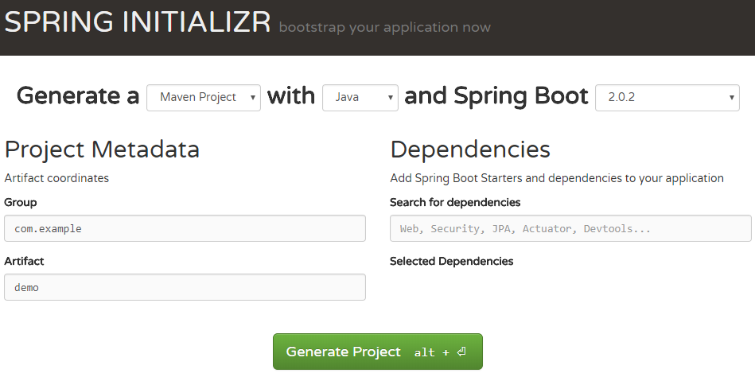
To make a Spring Boot Project

Slide 4
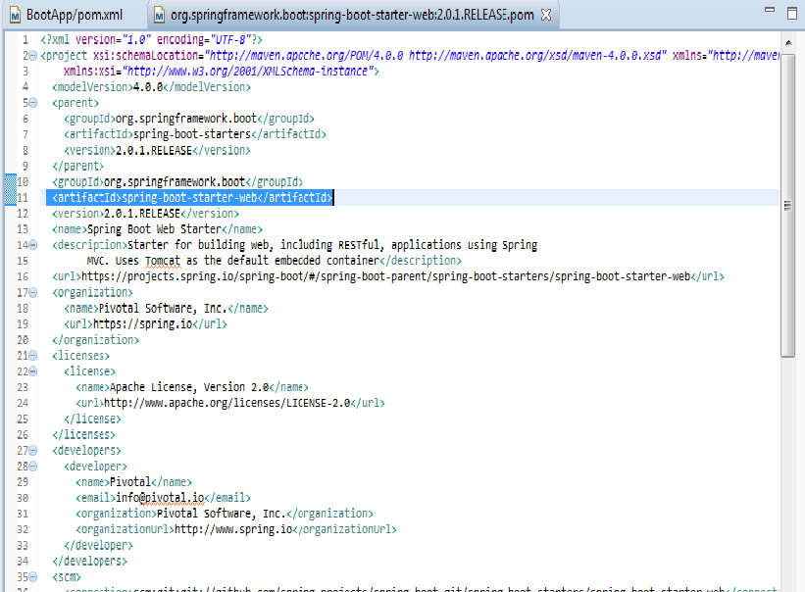
Inside starter-web…k

Slide 5
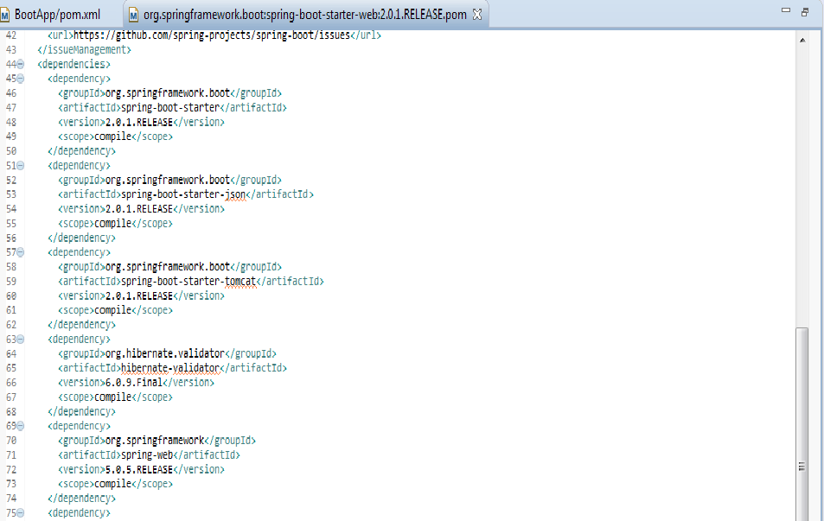
Spring Boot has an embedded server

Slide 6
WHY SPRING BOOT?

Slide 7

What Spring Does?
<bean name="customerDao" class="com.day6.dao.CustomerDaoImpl">
</bean>
<bean name="customerService" class="com.day6.service.CustomerServiceImpl">
<!-- <property name="custDao" ref="customerDao" ></property> -->
<constructor-arg index ="0" ref="customerDao"></constructor-arg>
</bean>

Slide 8
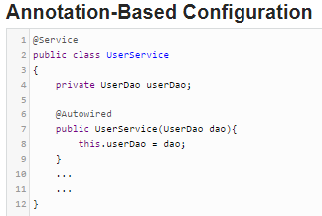
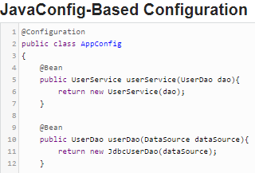

Slide 9
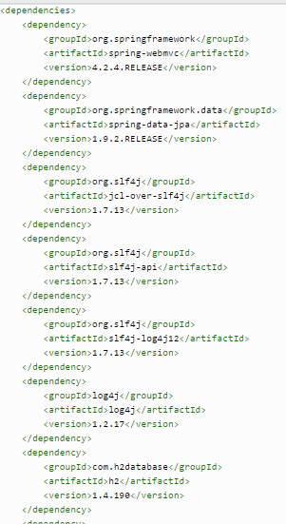
pom in spring

Slide 10
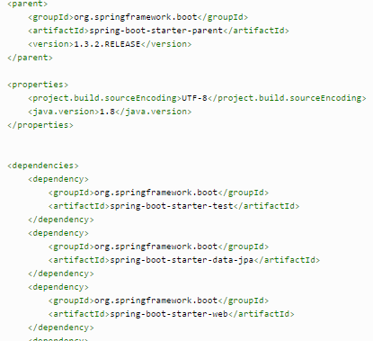
What Spring Boot pom Looks Like..

Slide 11
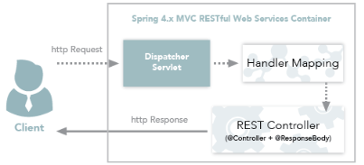
Annotations
RestController

Slide 12
Annotations
SpringBootApplication
EnableAutoConfiguration
ComponentScan

Slide 13
THANK YOU!! ☺

